Slide 1

SIT1302 Internet Programming
UNIT 2
JavaScript
Ms.J.S.Vimali
SIT1302 School of Computing

Slide 2
JavaScript Comments
Not all JavaScript statements are "executed".
Code after double slashes // or between /* and */ is treated as a comment.
Comments are ignored, and will not be executed:
var x = 5; // I will be executed
// var x = 6; I will NOT be executed
JavaScript Identifiers
Identifiers are names.
In JavaScript, identifiers are used to name variables (and keywords, and functions, and labels).
The rules for legal names are much the same in most programming languages.
In JavaScript, the first character must be a letter, or an underscore (_), or a dollar sign ($).
Subsequent characters may be letters, digits, underscores, or dollar signs.
Numbers are not allowed as the first character.
This way JavaScript can easily distinguish identifiers from numbers.
SIT1302 School of Computing

Slide 3
JavaScript is Case Sensitive
All JavaScript identifiers are case sensitive.
The variables lastName and lastname, are two different variables
<!DOCTYPE html>
<html>
<body>
<h2>JavaScript is Case Sensitive</h2>
<p>Try change lastName to lastname.</p>
<p id="demo"></p>
<script>
var lastname, lastName;
lastName = "Doe";
lastname = "Peterson";
document.getElementById("demo").innerHTML = lastName;
</script>
</body>
</html>
SIT1302 School of Computing

Slide 4
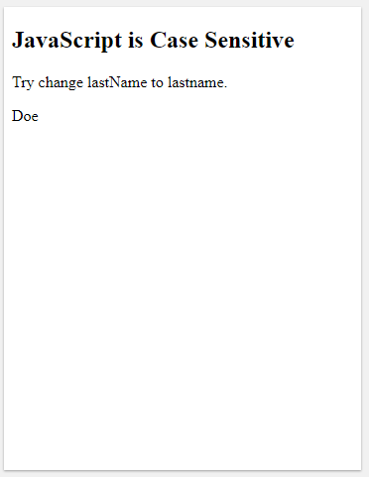
OUTPUT
SIT1302 School of Computing

Slide 5
JavaScript and Camel Case
Historically, programmers have used different ways of joining multiple words into one variable name:
Hyphens:
first-name, last-name, master-card, inter-city.
Hyphens are not allowed in JavaScript. They are reserved for subtractions.
Underscore:
first_name, last_name, master_card, inter_city.
Upper Camel Case (Pascal Case):
FirstName, LastName, MasterCard, InterCity.
Lower Camel Case:
JavaScript programmers tend to use camel case that starts with a lowercase letter:
firstName, lastName, masterCard, interCity.
SIT1302 School of Computing

Slide 6
JavaScript has five primitive data types:
null
undefined
boolean
number
String
and one complex data type called object.
JavaScript is a dynamic language or loosely typed therefore a variable does not associate with any type, however, its value does. In other words, the same variable can hold values of different types at any time.
let foo = 120; // foo is a number
foo = false; // foo is now a boolean
foo = "foo"; // foo is now a string
To get the current type of the value of a variable, you use the typeof operator
SIT1302 School of Computing

Slide 7
JavaScript Types are Dynamic
JavaScript has dynamic types. This means that the same variable can be used to hold different data types:
Example
  var x; // Now x is undefined
  x = 5; // Now x is a Number
  x = "John"; // Now x is a String
SIT1302 School of Computing

Slide 8
<!DOCTYPE html>
<html>
<body>
<h2>JavaScript Data Types</h2>
<p>JavaScript has dynamic types. This means that the same variable can be used to hold different data types:</p>
<p id="demo"></p>
<script>
var x; // Now x is undefined
x = 5; // Now x is a Number
x = "John"; // Now x is a String
document.getElementById("demo").innerHTML = x;
</script>
</body>
</html>
SIT1302 School of Computing

Slide 9
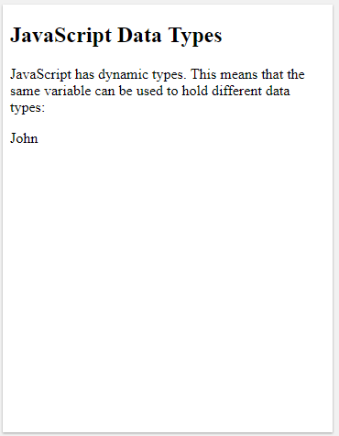
OUTPUT
SIT1302 School of Computing
OUTPUT

Slide 10
JavaScript Strings
A string (or a text string) is a series of characters like "John Doe".
Strings are written with quotes. You can use single or double quotes
<!DOCTYPE html>
<html>
<body>
<h2>JavaScript Strings</h2>
<p>Strings are written with quotes. You can use single or double quotes:</p>
<p id="demo"></p>
<script>
var carName1 = "Volvo XC60";
var carName2 = 'Volvo XC60';
document.getElementById("demo").innerHTML = carName1 + "<br>" + carName2;
</script></body></html>
SIT1302 School of Computing

Slide 11
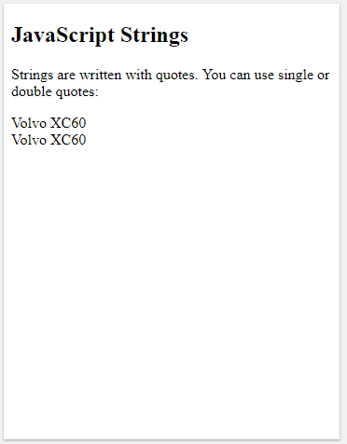
OUTPUT
SIT1302 School of Computing

Slide 12
JavaScript Numbers
JavaScript has only one type of numbers.
Numbers can be written with, or without decimals
<!DOCTYPE html>
<html>
<body>
<h2>JavaScript Numbers</h2>
<p>Numbers can be written with, or without decimals:</p>
<p id="demo"></p>
<script>
var x1 = 34.00;
var x2 = 34;
var x3 = 3.14;
document.getElementById("demo").innerHTML =
x1 + "<br>" + x2 + "<br>" + x3;
</script>
</body></html>
SIT1302 School of Computing

Slide 13
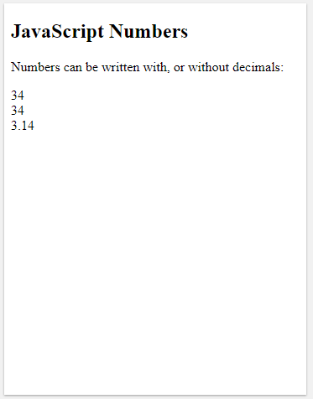
OUTPUT
SIT1302 School of Computing

Slide 14
JavaScript Booleans
Booleans can only have two values: true or false.
<!DOCTYPE html>
<html>
<body>
<h2>JavaScript Booleans</h2>
<p>Booleans can have two values: true or false:</p>
<p id="demo"></p>
<script>
var x = 5;
var y = 5;
var z = 6;
document.getElementById("demo").innerHTML =
(x == y) + "<br>" + (x == z);
</script>
</body>
</html>
SIT1302 School of Computing

Slide 15
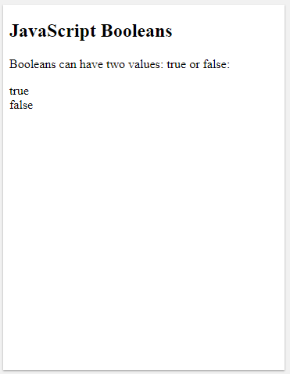
OUTPUT
Booleans are often used in conditional testing.
You will learn more about conditional testing later in this tutorial.
SIT1302 School of Computing

Slide 16
JavaScript Arrays
JavaScript arrays are written with square brackets.
Array items are separated by commas.
The following code declares (creates) an array called cars, containing three items (car names)
<!DOCTYPE html>
<html>
<body>
<h2>JavaScript Arrays</h2>
<p>Array indexes are zero-based, which means the first item is [0].</p>
<p id="demo"></p>
<script>
var cars = ["Saab","Volvo","BMW"];
document.getElementById("demo").innerHTML = cars[0];
</script>
</body>
</html>
SIT1302 School of Computing

Slide 17
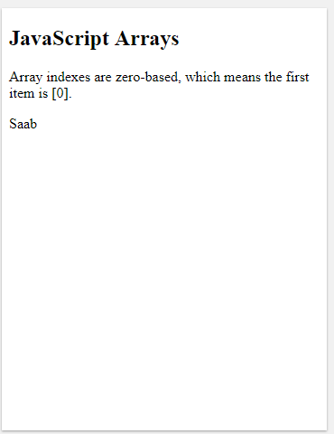
OUTPUT
Array indexes are zero-based, which means the first item is [0], second is [1], and so on.
You will learn more about arrays later in this tutorial.
SIT1302 School of Computing

Slide 18
JavaScript Objects
JavaScript objects are written with curly braces {}.
Object properties are written as name:value pairs, separated by commas.
<!DOCTYPE html>
<html>
<body>
<h2>JavaScript Objects</h2>
<p id="demo"></p>
<script>
var person = {
firstName : "John",
lastName : "Doe",
age : 50,
eyeColor : "blue"
};
document.getElementById("demo").innerHTML =
person.firstName + " is " + person.age + " years old.";
</script></body></html>
SIT1302 School of Computing

Slide 19
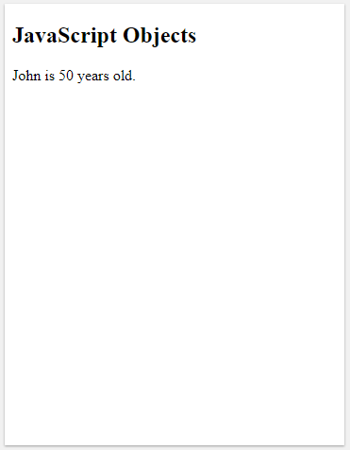
OUTPUT
The object (person) in the example above has 4 properties: firstName, lastName, age, and eyeColor.
You will learn more about objects later in this tutorial.
SIT1302 School of Computing

Slide 20
The typeof Operator
You can use the JavaScript typeof operator to find the type of a JavaScript variable.
The typeof operator returns the type of a variable or an expression
<!DOCTYPE html>
<html>
<body>
<h2>JavaScript typeof</h2>
<p>The typeof operator returns the type of a variable or an expression.</p>
<p id="demo"></p>
<script>
document.getElementById("demo").innerHTML =
typeof 0 + "<br>" +
typeof 314 + "<br>" +
typeof 3.14 + "<br>" +
typeof (3) + "<br>" +
typeof (3 + 4);
</script></body></html>
SIT1302 School of Computing

Slide 21
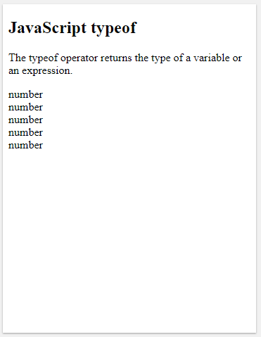
OUTPUT
SIT1302 School of Computing

Slide 22
Undefined
In JavaScript, a variable without a value, has the value undefined. The type is also undefined.
<!DOCTYPE html>
<html>
<body>
<h2>JavaScript</h2>
<p>The value (and the data type) of a variable with no value is <b>undefined</b>.</p>
<p id="demo"></p>
<script>
var car;
document.getElementById("demo").innerHTML = car + "<br>" + typeof car;
</script>
</body>
</html>
SIT1302 School of Computing

Slide 23
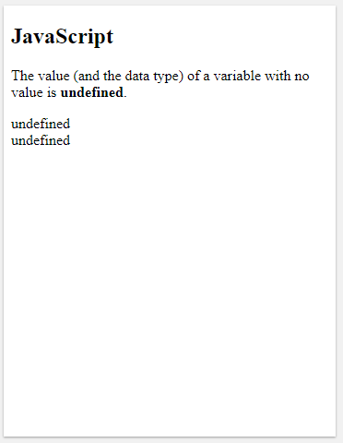
OUTPUT
Any variable can be emptied, by setting the value to undefined. The type will also be undefined.
SIT1302 School of Computing

Slide 24
Null
In JavaScript null is "nothing". It is supposed to be something that doesn't exist.
Unfortunately, in JavaScript, the data type of null is an object.
You can consider it a bug in JavaScript that typeof null is an object. It should be null.
You can empty an object by setting it to null
<!DOCTYPE html>
<html>
<body>
<h2>JavaScript</h2>
<p>Objects can be emptied by setting the value to <b>null</b>.</p>
<p id="demo"></p>
<script>
var person = {firstName:"John", lastName:"Doe", age:50, eyeColor:"blue"};
person = null;
document.getElementById("demo").innerHTML = typeof person;
</script>
</body></html>
SIT1302 School of Computing

Slide 25
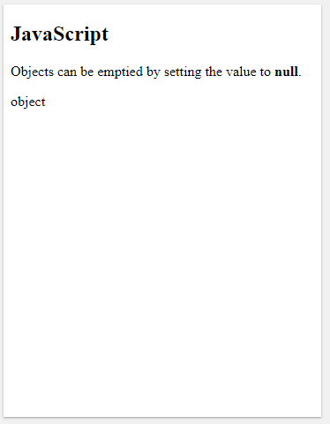
OUTPUT
SIT1302 School of Computing

Slide 26
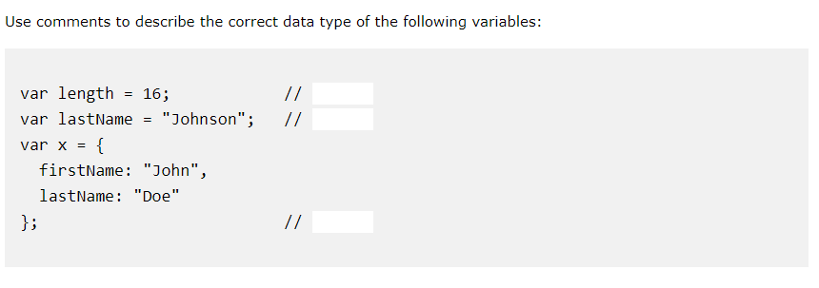
SIT1302 School of Computing

